Slide 1
Figure 1 new version 0227

Slide 2
Steps
1. find three real RNAs, plot them in 2D plots.
2. Draw an intact sample plot accordingly
3. build a bar plot for the most abundant RNA sequence
4. ladder assembly in PPT.
5. Draw an intact sample with only low intensity RNAs remaining.
6. Produce sequence output.

Slide 3
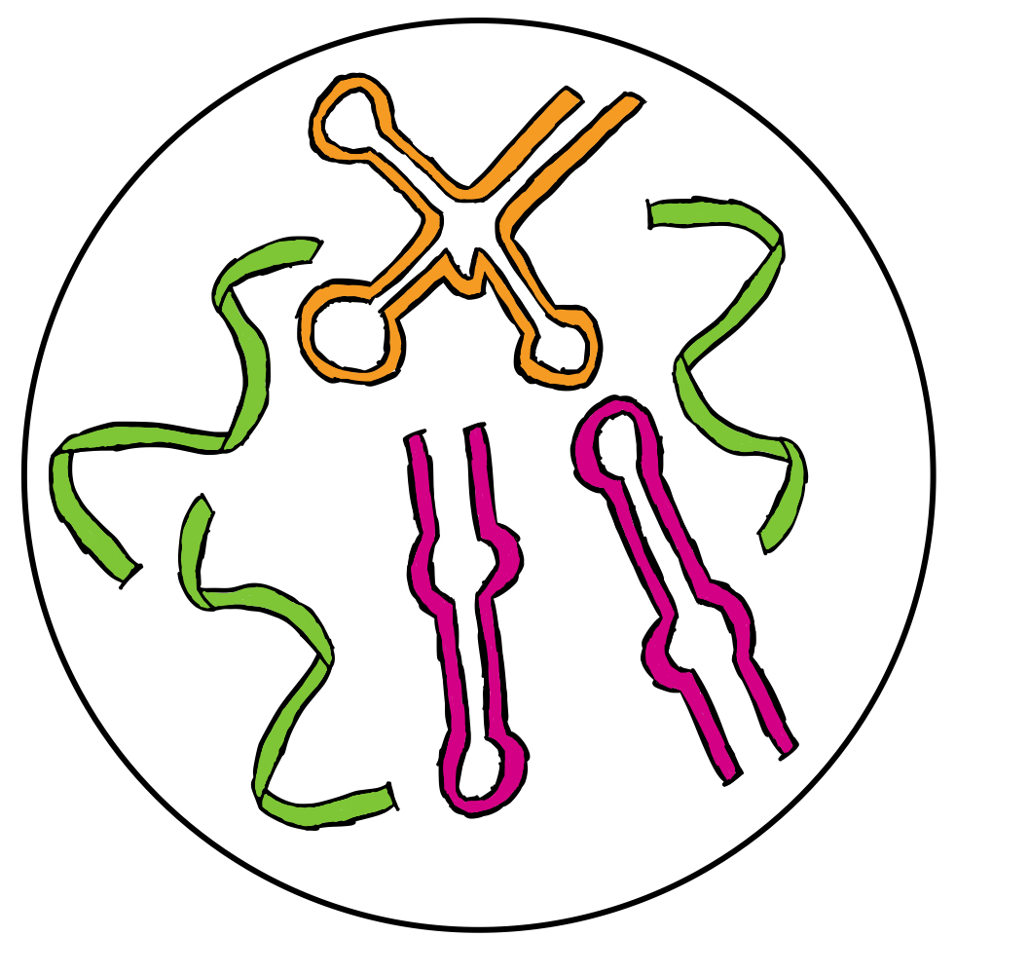
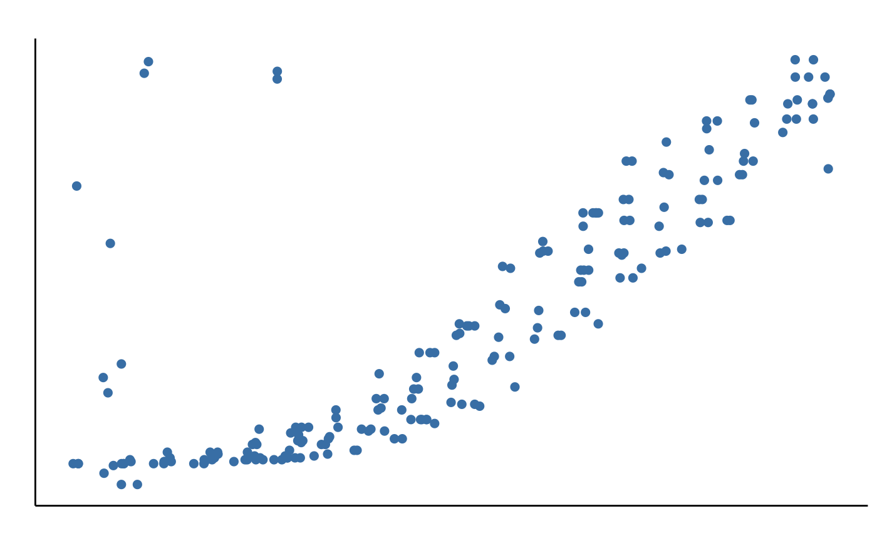
① No hydrolysis treatment
Determine number of RNAs and their sum intensity in the sample respectively
LC-MS
t_{R}
② Controlled Hydrolysis
+
LC-MS
_{Mass}
③ Start base calling from the mass point with highest sum intensity in the dataset
④ Generate ladder
Repeat step ③&④ until exhausion
⑤ Assemble all previously generated ladders
⑥ Final Sequence Output

